Slide 1
Intro to nutrition

Slide 2
What is nutrition?
Nutrition: The processes by which an animal or plant takes in a utilizes food substances.
In humans, nutrition is mainly achieved through the process of putting food into our mouths, chewing, and swallowing it.

Slide 3
Obesity in the usa
In the US, there has been:
A 200% increase in overweight children since the late 1960’s
1 out of 3 American children are overweight or obese
2/3 of American adults are overweight or obese
But Why??

Slide 4
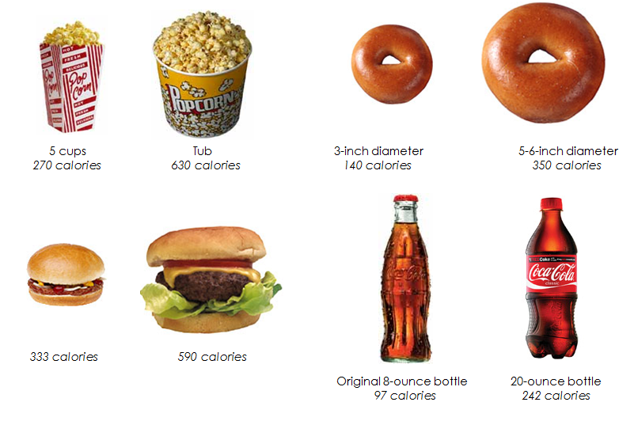
Poor nutrition
Too many unhealthy choices
Portion sizes are too large
We drink too many calories
Not enough exercise…

Slide 5
And…
5. Lack of education

Slide 6
Fundamentals of nutrition
Most people know there is a fundamental relationship between food and health.
But… many do not know what nutrients are needed or are not able to choose proper foods for optimum health.
Think Pair Share: What are some reasons people would not be able to choose these foods? (Be prepared to share your discussion with the class).

Slide 7
Effects of good nutrition
Healthy appearance
Good attitude
Proper sleep and bowel habits
High energy level
Enthusiasm and freedom from anxiety

Slide 8
Effects of good nutrition
Diseases or conditions prevented or delayed through good nutrition:
Hypertension (high blood pressure)
Atherosclerosis (fat and cholesterol build up on artery walls)
Osteoporosis (thinning of the bones)
Malnutrition (lack of proper nutrients)

Slide 9
Think pair share
What are the nutrients essential to good nutrition?
(Hint: There’s 6 of them, and it’s not the food groups!)

Slide 10
Nutrient groups/essential nutrients
There are 6 nutrients that are essential to growth, reproduction, and good health. These are:
Fats
Protein
Carbohydrates
Vitamins
Minerals
Water

Slide 11
Calories & macronutrients
Calorie (as it pertains to nutrition): a unit of energy.
Macronutrient: a substance required in relatively large amounts by living organisms.
Every day, to function properly, your body needs a certain amount of energy. That energy comes from the following macronutrients:
Fat,
Protein, and
Carbohydrates

Slide 12
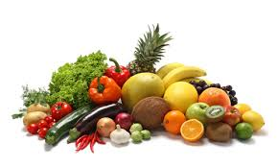
micronutrients
Micronutrients: Substances required in trace or smaller amounts for the normal growth and development of living organisms.
Vitamins and Minerals

Slide 13
And…
Water! (Which I guess technically could be a macronutrient…)

Slide 14
fats
Healthy fats are an important part of a healthy diet.
Fats help your body with: vitamin and mineral absorption, blood clotting, building cells, muscle movement, and improving brain function.
20-30% of your daily calorie intake should come from fats.
Fats are powerful anti-inflammatories, and may lower your risk of arthritis, cancer, and Alzheimer’s disease.

Slide 15
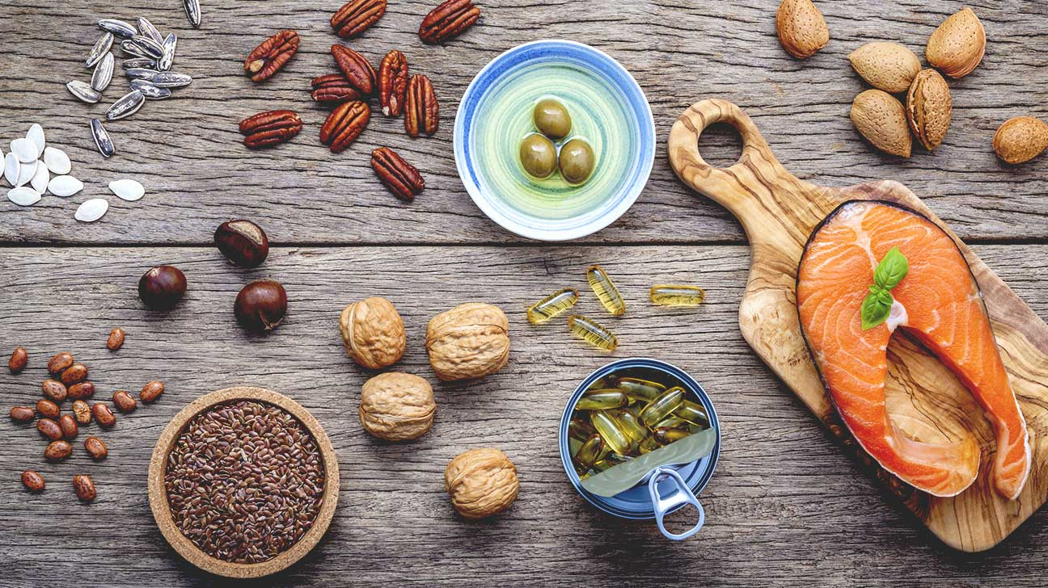
Fats cont.
Healthy sources of fats include:
Unsaturated Fats: Omega-3 and Omega-6 fatty acids; which can be found in nuts, seeds, fish, and healthy vegetable oils (i.e. olive, sunflower, and canola).
Saturated Fats: should be limited (i.e. butter, cheese, red meat, and ice cream) and Trans Fats should be avoided.

Slide 16
protein
Protein provides building blocks for your body (and not just muscle!). Every cell, from bone, to skin, to hair, contains protein.
Protein is used primarily for growth, health, and body maintenance. Hormones and antibodies are made of protein. Protein is not used to fuel the body unless necessary (i.e. when in starvation mode).

Slide 17
Amino acids
When proteins are digested or broken down, amino acids are left. There are two types of amino acids: Essential and Non Essential.
Essential: Essential amino acids cannot be made by the body, and therefore need to come from food.
Non Essential: Non essential means our bodies can produce amino acids, even if we do not get them from food.

Slide 18
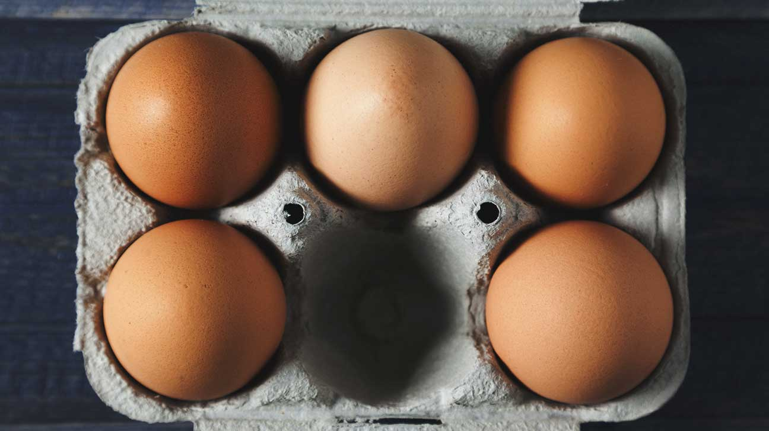
Protein cont.
Healthy sources of protein include:
Meat
Fish
Eggs
Beans
Soy
Nuts
Males need about 56 grams of protein per day; Females need about 46 grams per day. This can vary based on your age
and activity level.

Slide 19
carbohydrates
Don’t let the low carb craze (i.e. keto diets) fool you; carbohydrates are necessary for a healthy body.
Carbs fuel your central nervous system and brain, and help protect against diseases.
Carbs should make up 45-65% of your daily calories.

Slide 20
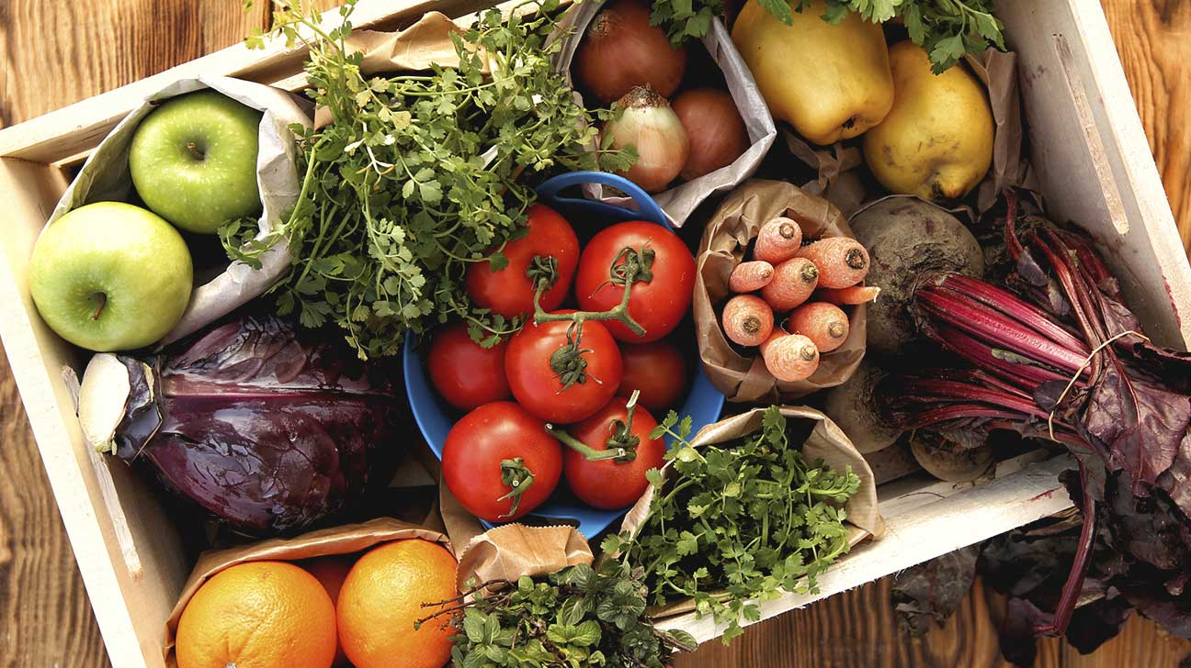
Carbohydrates: quality matters!
Simple Carbohydrates
These translate into sugar in your body and include baked goods, cookies, cereal, white bread, and pastas.
Complex Carbohydrates
These are made up of fiber and starch, which help your body with bowel regulation and cholesterol control.
Healthy Sources include: Fruits, vegetables, nuts, beans, whole grains, oats, peas, and rice.

Slide 21
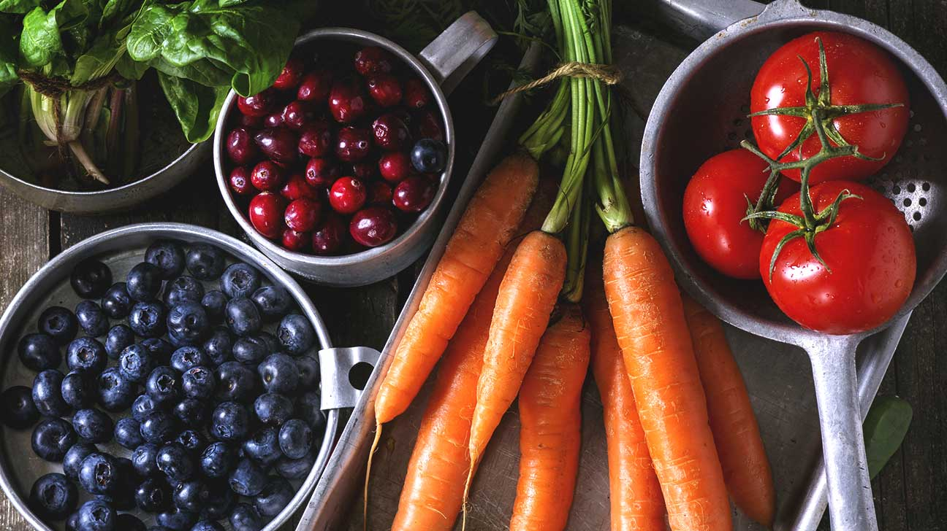
vitamins
Vitamins are vital for warding off disease and staying healthy. The body needs these micronutrients to support its functions, maintain healthy vision, skin, and bones, and help prevent the risk of certain cancers (i.e. lung and prostate). Vitamins also help boost the immune system and help the body heal.

Slide 22
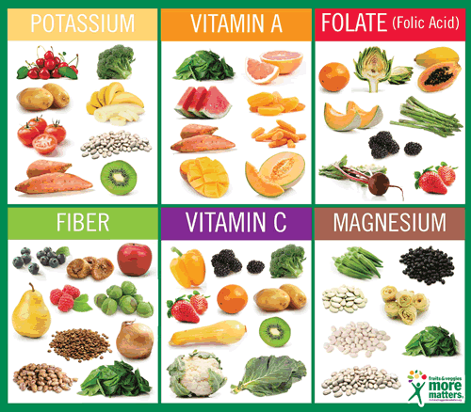
Vitamins cont.
If you eat a varied, well-balanced diet full of fruits and vegetables, you likely don’t need to take vitamin supplements.

Slide 23
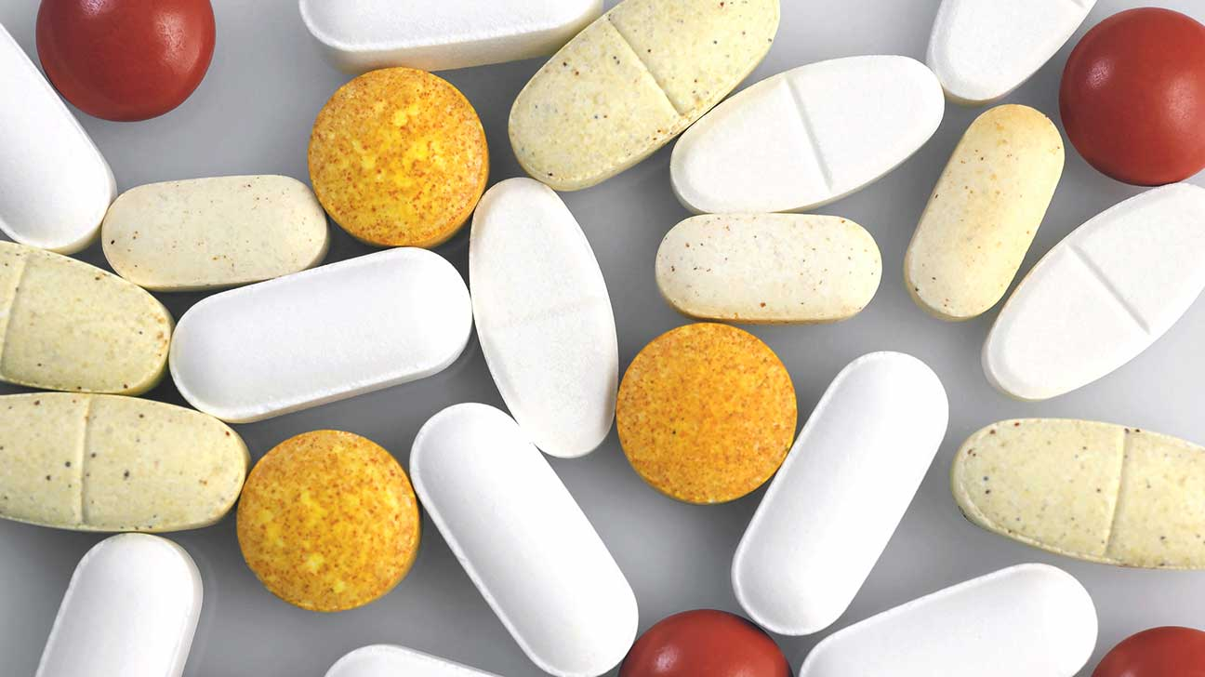
Minerals
Like vitamins, minerals help support the body. They are essential for many functions, such as building strong bones and teeth, metabolism, and staying properly hydrated.
Some examples of minerals include: calcium, iron, and zinc. Different minerals can be found in almost all foods (i.e. calcium in dairy and iron in red meat and leafy greens)
There are many supplements available, and lots of contradicting research. You should speak with your physician and consider having blood work done before beginning to take supplements.

Slide 24
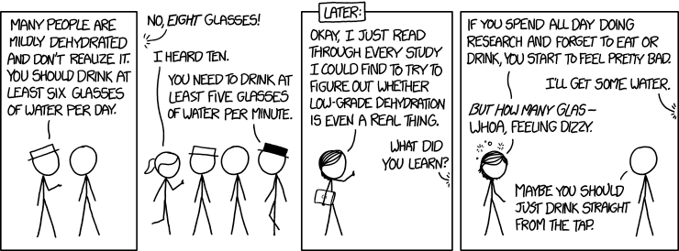
water
You can go for weeks without food, but only a few days without water. Water is crucial for every system in your body. In fact, about 60% of your body is water.
Water improves your brain function and mood. It acts as a shock absorber and can help flush out toxins, carry nutrients to cells, and prevent constipation.

Slide 25
Water cont.
Healthy Sources: Water!! Also, spinach and watermelon are great sources. If drinking water is a challenge, try adding fresh fruits or vegetables to it (try strawberries and mint, cucumber, or lemon).
The best way to know if you are properly hydrated is by checking your urine. You should pee copiously, clearly, and often!

Slide 26
Jamie oliver
Ted Talks: https://www.ted.com/talks/jamie_oliver
21 minute video, watch, process, and take notes.
Fun fact: Jamie and his wife, Juliette, have five children, whom are named- Poppy Honey Rosie, Daisy Boo Pamela, Petal Blossom Rainbow, Buddy Bear Maurice, and River Rocket.

Slide 27
Food groups

Slide 28
Dietary reference intake (DRI)
DRI is the general term for a set of reference values used to plan and assess the nutrient intakes of people. These values, which vary by age, gender, and activity level, include:
Recommended Dietary Allowance (RDA): Average daily level of intake sufficient to meet the nutrient requirements of nearly all healthy people.
Adequate Intake (AI): Established when evidence is insufficient to develop an RDA and is set at a level assumed to ensure nutritional adequacy.
Tolerable Upper Intake Level (UL): Maximum daily intake unlikely to cause adverse health effects.
More info can be found here: https://ods.od.nih.gov/Health_Information/Dietary_Reference_Intakes.aspx

Slide 29
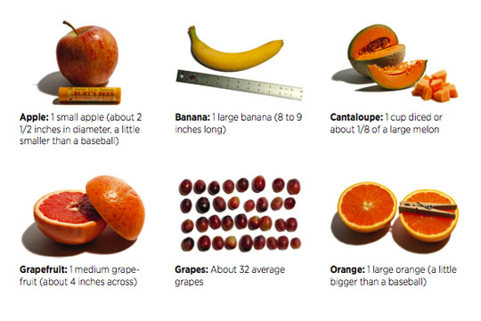
fruits
You need 1 ½ to 2 cups/servings per day.
One Serving=
Apple- 1 small or ½ large
Applesauce- 1 cup
Banana- 1 large
Melon- 1 cup diced
Grapes- 1 cup or 32
Orange- 1 large
Pear- 1 medium
Strawberries- 8 or 1 cup, diced
Dried Fruit- ½ cup

Slide 30
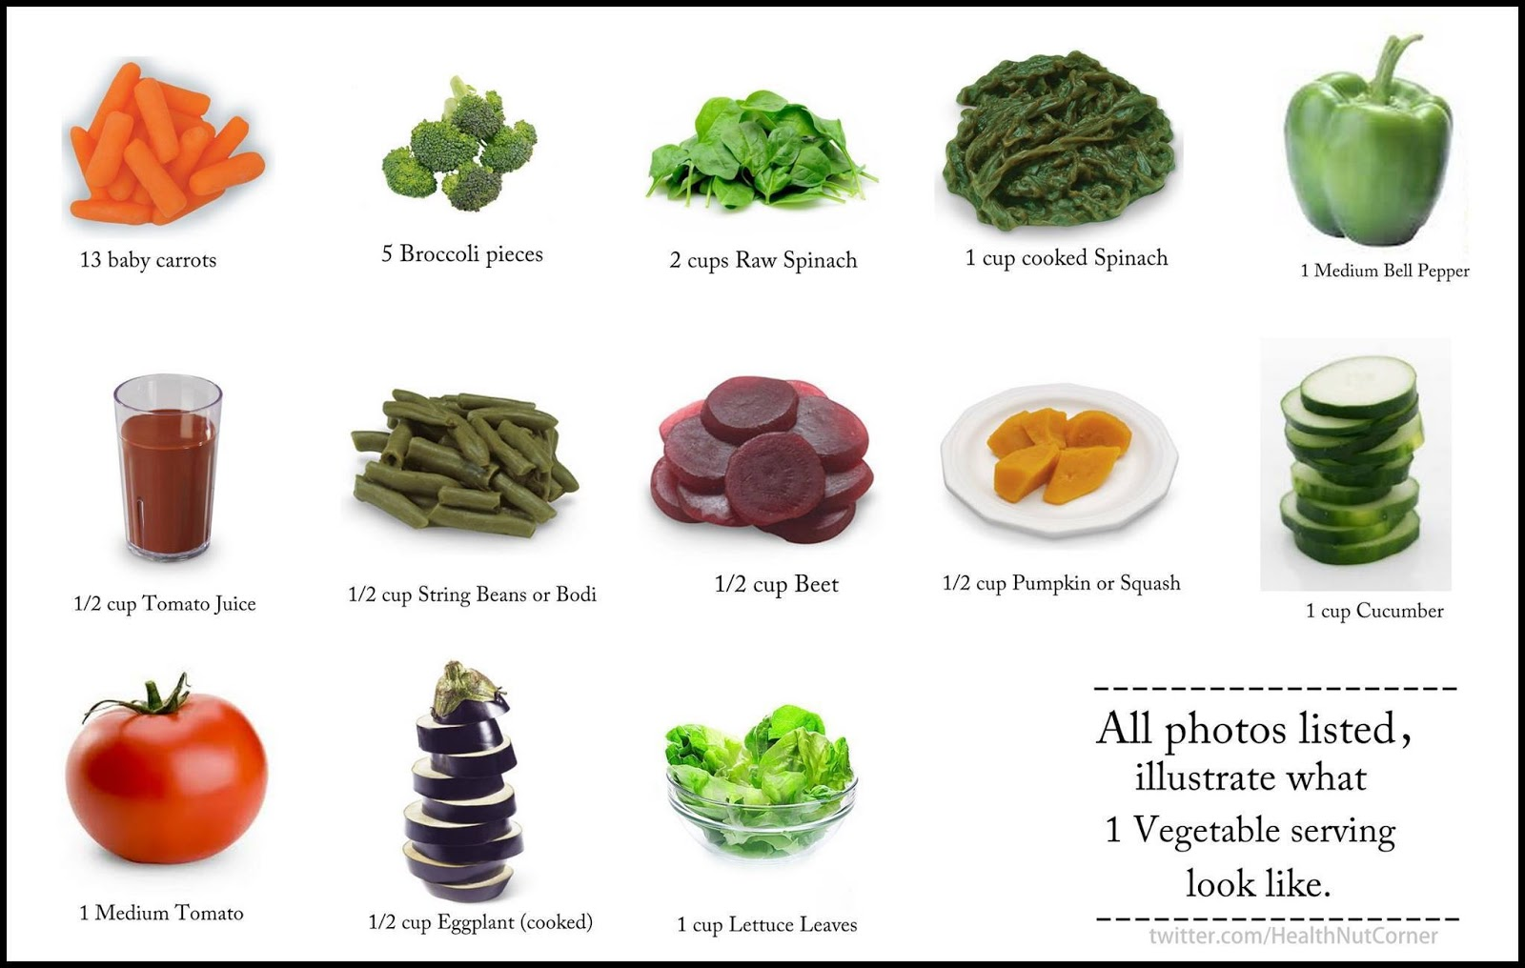
vegetables
You need 2-3 servings per day.
In general, 1 cup of raw or cooked vegetables and 2 cups of leafy greens counts as one serving.

Slide 31
grains
Any food made from wheat, rice, oats, cornmeal, barley, or another cereal grain is considered a grain product. Examples include: bread, pasta, oats, grits, and tortillas.
Grains are divided in two subgroups: whole and refined.
Whole grains contain the entire grain kernel.
Examples: whole-wheat flour, bulgur (cracked wheat), oatmeal, and brown rice.
Refined grains have been milled, a process that removes the bran and the germ. This is done to give the grains a finer texture and improve shelf life. But, it also removes, dietary fiber, iron, and most B vitamins. Therefore, most refined grains are enriched, which means they add these back into the product.
Examples: white bread, white flour, white rice

Slide 32
Anatomy of a grain

Slide 33
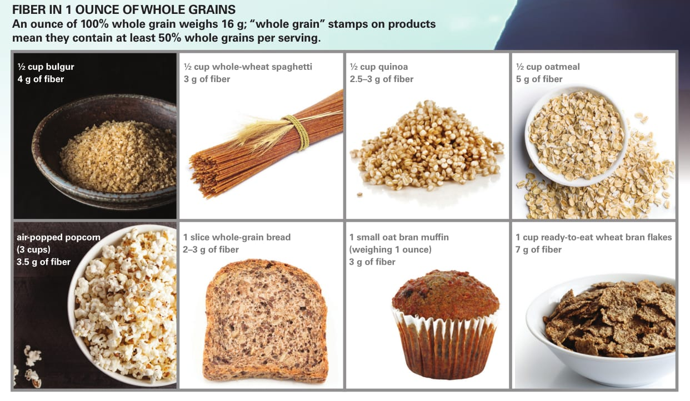
Grains cont.
You need about 7 ounces/servings per day. At least half of this should come from whole grains.
One serving, or one ounce, can be counted as 1 slice of bread, 1 cup of ready to eat cereal, or ½ cup of cooked rice, pasta, or cooked cereal.

Slide 34
protein
Any food made from meat, poultry, seafood, beans, peas, processed soy products, eggs, nuts, and seeds are considered protein products.
Select a variety of protein foods per week, including at least 8 ounces of seafood. Meat and poultry choices should be low fat/lean. This does not apply to vegetarians, whose protein food sources include beans and peas, processed soy products, and nuts and seeds.

Slide 35
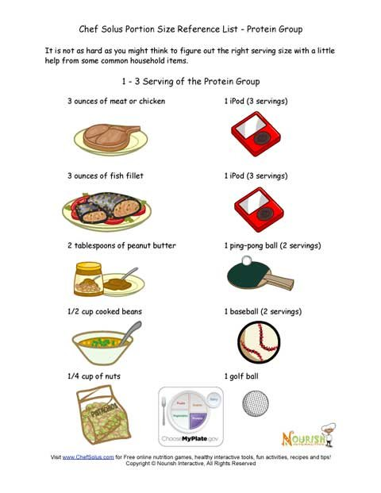
Protein cont.
You need 5-6 ½ ounces of protein per day.
In general, one ounce is 1 ounce of meat, poultry, or fish, ¼ cup of cooked beans or peas, 1 egg, 1 tablespoon of peanut butter, or ½ ounce of nuts or seeds.

Slide 36
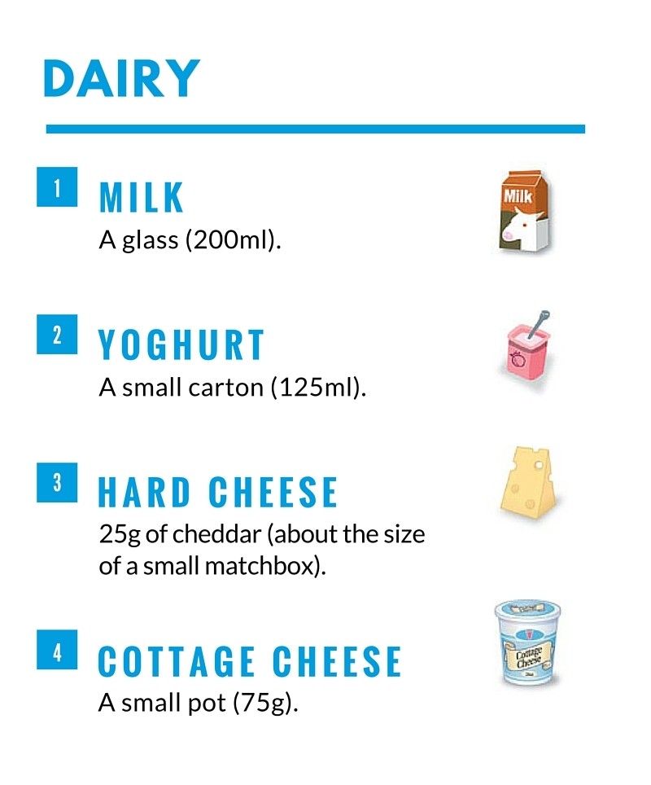
dairy
You need 3 cups of dairy per day.
One serving includes one cup of milk, yogurt, milk-based desserts, and soymilk or 1 slice of cheese, 1/3 cup shredded cheese, and 2 cups cottage cheese.

Slide 37
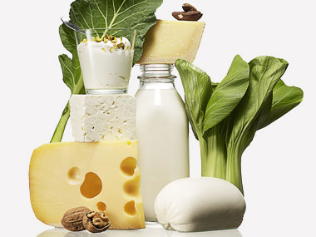
Dairy cont.
If you do not eat dairy, you can get calcium from other sources:
Kale, Calcium-fortified rice milk, almond milk, or (some-ish) cereals, canned fish, soybeans and other soy products, some other beans, collard and turnip greens, and bok choy.

Slide 38
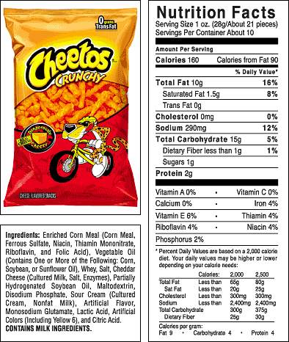
Food labels

Slide 39
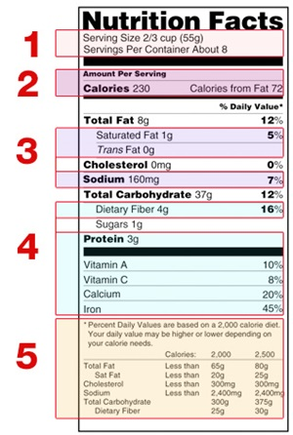
Food labels
Start with the serving information.
This will tell you the size of a single serving and the total number of servings per container (package).
Next, check total calories per serving.
Pay attention to the calories per serving and how many you’re consuming if you eat the whole package. If you double the servings you eat, you double the calories and nutrients.

Slide 40
Food labels
3. Limit these nutrients.
Limit the amounts of saturated fat and sodium you eat, and avoid trans fat. Choose foods with less of these nutrients when possible.
4. Get enough of these nutrients.
Make sure you get enough beneficial nutrients such as: dietary fiber, protein, calcium, iron, vitamins, and other nutrients you need every day.

Slide 41
Food labels
5. Quick guide to % Daily Value
The % Daily Value (DV) tells you the percentage of each nutrient in a single serving, in terms of the daily recommended amount. As a guide, if you want to consume less of a nutrient (i.e. saturated fat or sodium) choose foods with a DV of 5% or less. If you want to consume more of a nutrient (i.e. fiber), choose foods with a DV or 20% or more.

Slide 42
Food label tips
Remember that the information shown on food labels is based on 2,000 calories per day. You may need to consume more or less depending on your age, gender, activity level, and whether you’re trying to lose, gain, or maintain your weight.
When the nutrition facts label says a food contains “0 g” trans fat, but includes “partially hydrogenated oil” on the ingredient list, it means the food contains less than .5 g trans fat per serving. So, if you eat more than one serving, you can quickly reach your daily limit of trans fat.

Slide 43
Changes to food labels
Changes are being made to food labels for a variety of reasons:
The current label is more than 20 years old. In order to make sure consumers have access to recent, accurate, and relevant information, changes need to be made.
The changes made are based on updated scientific information, new nutrition and public health research, more recent dietary recommendations from expert groups, and input from the public.

Slide 44
Original vs new format

Slide 45
Highlight of what’s different

Slide 46
Serving size update

Slide 47
Bilingual label

Slide 48
10 best/worst foods
Worst: https://cspinet.org/eating-healthy/foods-to-avoid/10-worst-foods
Best: https://cspinet.org/eating-healthy/what-eat/10-best-foods

Slide 49
activity
Let’s practice reading some food labels!

