Slide 1
Reading Food Labels

Slide 2
Updates
The current food label is over 20 years old!
As of July 26, 2016, the Food and Drug Administration required an update.
The Nutrition Facts label was updated with the following goals in mind:
Current findings in nutrition research
Reflect the eating habits of Americans
Emphasize calories and serving size
Focus on under consumed nutrients

Slide 3
Compliancy
Food manufacturers with sales greater than $10 million have until July 26, 2018 to comply.
Those with sales less than $10 million have an additional year.

Slide 4
Serving Sizes
Federal law now requires that serving sizes be based on amounts of food and beverages that people are actually eating, not what they should be eating. This is called Reference Amounts Customarily Consumed (RACC).

Slide 5
Examples
Ice cream: old serving size- ½ cup; new serving size- 2/3 cup
Yogurt: old serving size- 8 ounces; new serving size- 6 ounces
Soda: old serving size- 8 ounces; new serving size- 12 ounces (Note: labels on 20-ounce bottles will state servings per container as one serving, because most people consume a bottle in one sitting).

Slide 6
Calories
Calories from fat no longer appears. This change is due to the fact that current nutrition research states the type of fat is more important than the amount of fat.
For example, foods that are not low in total fat, but have lots of mono- and polyun-saturated fats may be considered “healthy” (think, avocados…).

Slide 7
Percent Daily Values (%DV)
Updated to reflect the following changes in dietary recommendations (per 2,000 calorie diet).
Total fat: increased from 30-35% of total calories (65g to 78g).
Total carbohydrate: decreased from 300g to 275g
Dietary fiber: increased from 25g to 28g
Sodium: decreased from 2,400mg to 2,300mg
Potassium: increased from 1,000mg to 1,300 mg
Vitamin D: increased from 10 micrograms to 20 micrograms (400 IC to 800 IU)

Slide 8
Added Sugars
The amount of added sugars a food contains will now be identified on the nutrition label.
This is because consuming foods high in added sugars decreases the amount of nutrient-dense foods consumed AND increases total calories consumed.
Diets lower in sugar are associated with reduced risk of heart disease.

Slide 9
Added Sugars Cont.
The wording “Includes X g Added Sugars” is used to make it clear that added sugars represent only a portion of the “Total Sugars” a food naturally contains.
The amount of total sugars includes both added and naturally occurring sugars.
For example, milk contains a lot of “Total Sugars” due to the lactose which naturally occurs in milk, but contains no added sugars.

Slide 10
Added Sugars Cont.
The Food and Drug Administration defines added sugars as sugars that are either added during the processing of foods, or are packaged as such (a sugar packet or bag of brown sugar).
Added sugars include: syrups, brown sugar, high fructose corn syrup, invert sugar, maltose, trehalose, honey, molasses, sucrose, maltose sugar, lactose, and concentrated fruit juice.

Slide 11
Sugar and % DV
The %DV for added sugars is also on the new label. This is 10% or total daily calories.
Therefore, if your recommended intake is 2,300 calories per day, you should not consumer more than 230 calories per day from added sugars.

Slide 12
Nutrients of Concern
According to national food consumption surveys, Americans do not get enough vitamin D and potassium in their diets.
These diets are linked to greater risk of chronic diseases.
For this reason, vitamin D and potassium replace vitamins A and C (which used to be deficient in American diets, but are no longer). Vitamins A and C can still be voluntarily listed on the new labels.

Slide 13
Nutrients of Concern Cont.
Although artificial sources of trans fats from partially hydrogenated oils are no longer allowed, naturally occurring trans fats are still allowed.
Examples: cows and goats
Food manufacturers will be able to petition the FDA to use partially hydrogenated oil in products. These may or may not be approved.

Slide 14
Footnote
The footnote was revised to better explain % Daily Values. The calculate %DV, use the following formula:
(amount of nutrient in 1 serving of product ÷ recommended daily value) x 100 = %DV
Example:
(34g total carbohydrate ÷ 275g carbohydrate per day) x 100 = 12% DV

Slide 15
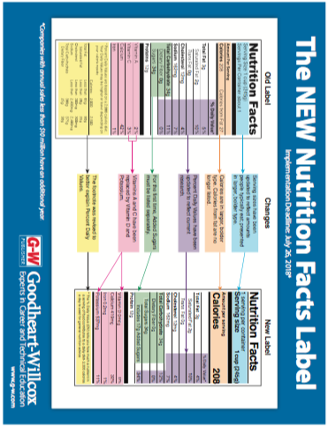

Slide 16
Let’s check in…
Who is required to use the revised Nutrition Label on their products?
When are they required to?
What is being changed?
Where is this change taking place (not geographically)?
Why are they making changes?

Slide 17
Who?
All food manufacturers will be required to use the revised Nutrition Facts label on their products.

Slide 18
When?
Food manufacturers with sales of $10 million per year or more must use the revised labels on their products no later than July 26, 2018.
Food manufacturers with sales less than $10 million per year have an additional year to comply.

Slide 19
What?
Serving sizes must be updated to reflect the amounts people typically eat. These serving sizes must appear in larger, bolder type.
Calories must also appear in larger, bolder type.
Calories from fat are no longer listed.
Percent Daily Values must be updated to reflect current research.
A new row must be added to show the amount of added sugars a product contains.
Vitamin D and Potassium will replace Vitamins A and C on the label.
The footnote has been revised to better explain Percent Daily Values.

Slide 20
Where?
Nutrition Fact labels are required on most food packages. Foods that provide no significant nutritional value (i.e. coffee, tea, many spices) are not required to.
Foods such as sliced meats sold at a deli counter in bulk do not require nutrition labels.
Foods sold at restaurants do not have to have nutrition fact labels (but they have to meet menu labeling requirements).

Slide 21
Why?
Nutrition and health researchers continue to discover more about the connection between what we eat and our health. In addition, people’s eating habits continue to change and evolve. As a result, the Nutrition Facts label has been revised to reflect these changes and provide more useful information to consumers as they make decisions about food choices.

Slide 22
Now, time for some follow up!
Turn to the next page in your packet and complete the New Nutrition Fact Label Worksheet

